Slide 1
WP4
Testing
Axel Luyten (presentation) & Alberto Castro (minutes)
30 Jan 2024

Slide 2
Agenda
Why we test
What to test: calculation pathways
How we test
DEMO adding a test
Discussion: Who tests what
Discussion: Which calculation pathways have priority?
Timeline

Slide 3
Why we test
We test to make sure that
the functions work properly (no errors & warning messages, output layout as expected, …)
the calculation results of the different pathways are correct

Slide 4
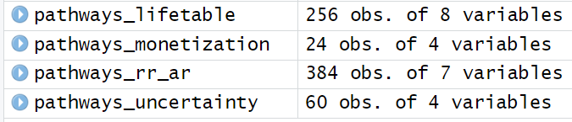
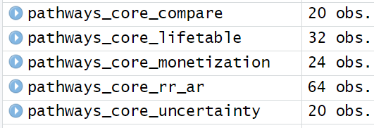
What we test
All theoretically possible pathways unrealistic, too many!
All relevant pathways
All core pathways
~ 700 (x 2 for compare() )
160

Slide 5
What we test
All theoretically possible pathways feeling close to ∞
All relevant pathways
All core pathways
~ 700 (x 2 for compare() )
160 ( - 200)

Slide 6
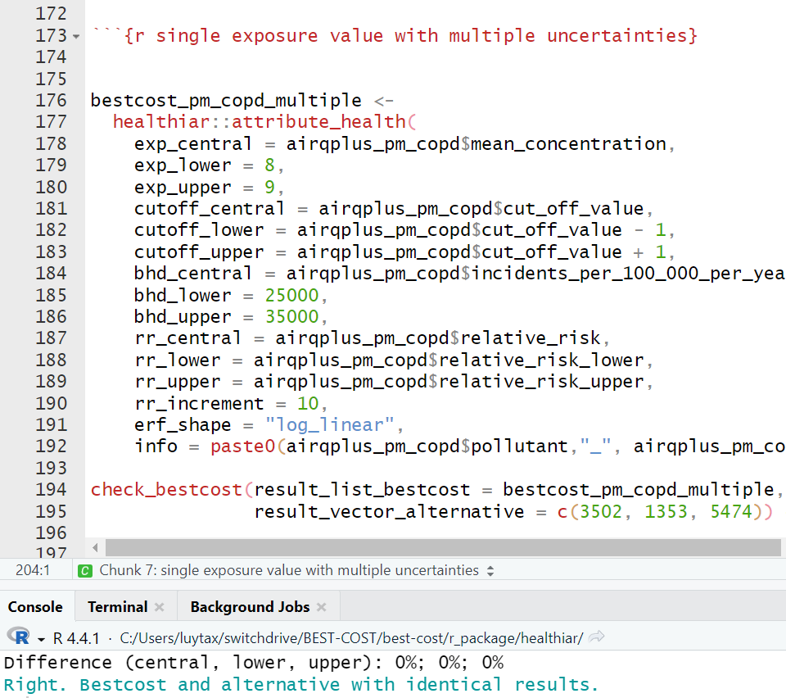
How we test (1)
Before: R markdown with test cases, which is a “home-made” short-term solution:
Call function
Compare results to comparison study/previous values
Print output
1
2
3

Slide 7
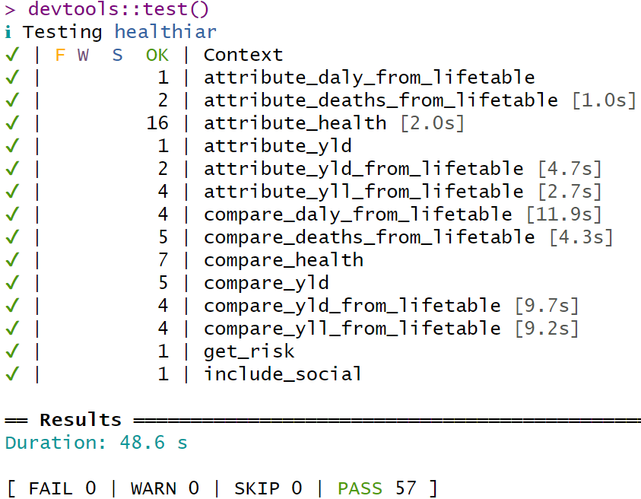
How we test (2)
After: Unit testing using R package test_that
More professional, standard and systematic approach
One script for each package function containing all tests of that function
Results from healthiar are compared with the expected results
devtools::test() checks all at once
83
BUT of these many only compared to PREVIOUS results, NOT compared to EXTERNAL study / assessment

Slide 8
How we test (3): adding a new test
Pick a pathway
Look for comparison assessment
Fill out the function template with the assessment input data
Check whether results of healthiar and your chose assessment are the same
Upload the test to Teams / GitHub

Slide 9
DEMO adding a new test
Pick a pathway
Look for comparison assessment
Fill out the function template with the assessment input data
Check whether results of healthiar and your chose assessment are the same
Upload the test to Teams / GitHub
Relative risk; ERF shape: log-linear; exposure distribution; with cutoff; no iteration, no input variable uncertainty
example_road_noise_niph
→ R Markdown
Yes!
Done

Slide 10
Discussion: Who tests what
Proposal:
Relative risk: Sciensano, TAI, CSTB (SPF), LMU
Iteration: Swiss TPH, Sciensano, JRC (Enrico?)
Social analysis: Sciensano
Summary uncertainty: (Sciensano), Swiss TPH
Absolute risk: NIPH
Monetization: UP
Lifetable: Swiss TPH, UBD-Policy (?), LMU (?)
Multipollutant: LMU
Prepare function: Sciensano, Swiss TPH, WP3? (MDI function), JRC (Enrico?)
Internal functions: Swiss TPH
Other aspects: summary uncertainty, prepare functions, … to be decided

Slide 11
Discussion: priority calculation pathways
There are too many calculation pathways, so we have to prioritize → core pathways
Which calculation pathways should we prioritize?
ERF shape: log-lin, user-defined formula, ERF from point-pairs
Options: "lin_lin", "log_lin", "lin_log", "log_log", "formula", "point_pairs“
Multiexposure
…

Slide 12
Timeline
To do: add at least one test until the next Nerd meeting
To get familiar with the process
To be able to exchange experiences during the meeting
“Get the low hanging fruits”
Hard deadline: cover core calculation pathways: end of June (before the external workshop(s))

Slide 13
Happy testing! : )

Slide 14
Discussion: Who tests what
Proposal:
Relative risk: Sciensano, TAI, CSTB, LMU
Absolute risk: NIPH
Monetization: UP
Lifetable: Swiss TPH (& UBD-Policy), LMU (?)
LMU, CSTB, TAI ?
Other aspects: summary uncertainty, prepare functions, … to be decided

